Slide 1
Course Code:CSC402A Course Title: Web Architecture and Application Development
Course Leader:
Kishore S.M.
kishore.cs.et@msruas.ac.in

Slide 2
Objectives
After completing this lecture, the student will be able to
Design and implement PHP validation
Analyze basics of Javascript

Slide 3
Contents
PHP Validation
Javascript

Slide 4
PHP
PHP- Forms
Dynamic Websites
The Websites provide the functionalities that can use to store, update, retrieve, and delete the data in a database
What is the Form?
A Document that containing black fields, that the user can fill the data or user can select the data. Casually the data will store in the data base

Slide 5
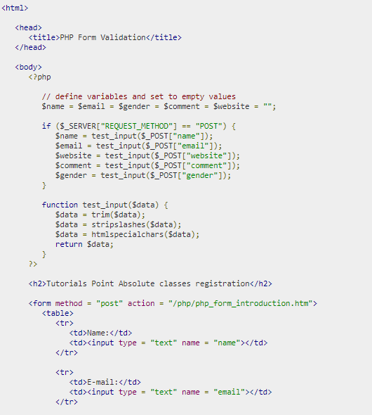
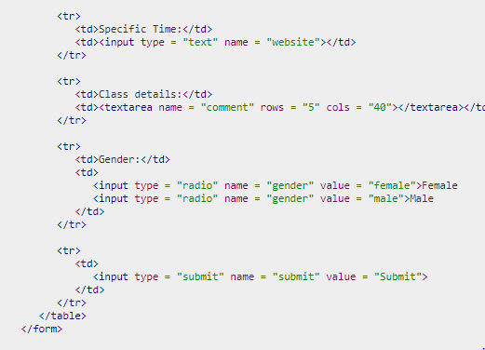
PHP
PHP- Forms

Slide 6
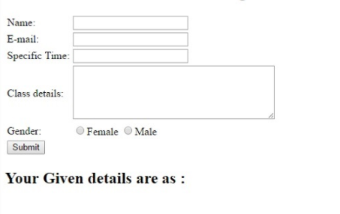
PHP
PHP- Forms

Slide 7
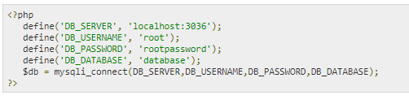
PHP
PHP - MySQL Login
Config.php
Config.php file is having information about MySQL Data base configuration.

Slide 8
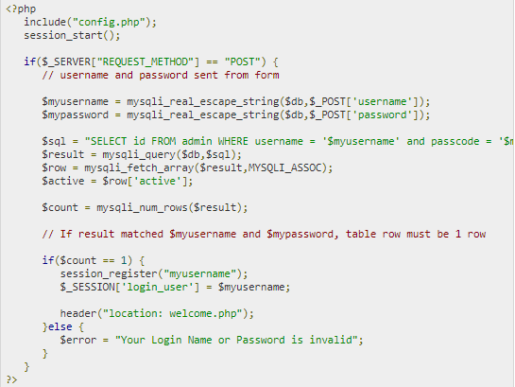
PHP
PHP - MySQL Login
Login.php
Login PHP is having information about php script and HTML script to do login.

Slide 9
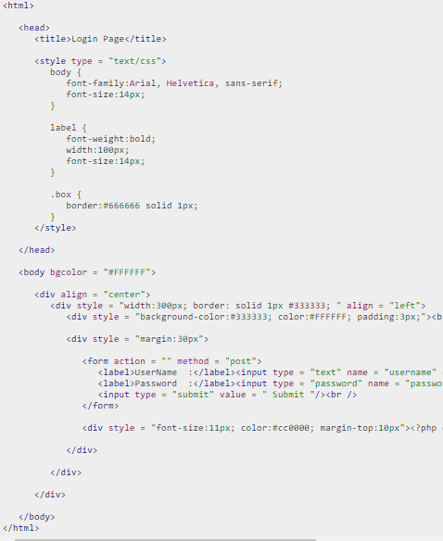
PHP
PHP - MySQL Login
Login.php
Login PHP is having information about php script and HTML script to do login.

Slide 10
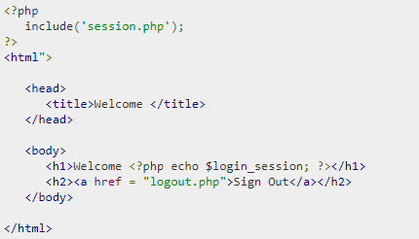
PHP
welcome.php
After successful login, it will display welcome page

Slide 11
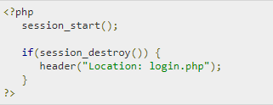
PHP
Logout page
Logout page is having information about how to logout from login session.

Slide 12
Javascript
JavaScript is a lightweight, interpreted programming language. It is designed for creating network-centric applications
It is complimentary to and integrated with Java
JavaScript is very easy to implement because it is integrated with HTML
It is open and cross-platform
JavaScript can be implemented using JavaScript statements that are placed within the <script>... </script> HTML tags in a web page.

Slide 13
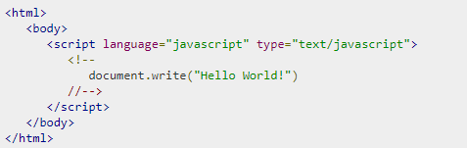
JavaScript
Your First JavaScript Script
This function can be used to write text, HTML, or both. Take a look at the following code.

Slide 14
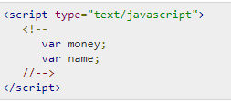
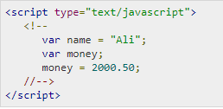
JavaScript
JavaScript Variables
Like many other programming languages, JavaScript has variables. Variables can be thought of as named containers. You can place data into these containers and then refer to the data simply by naming the container.

Slide 15
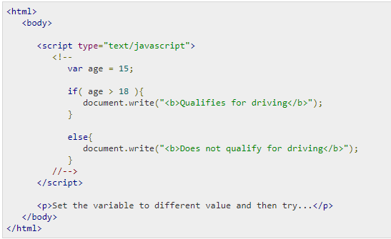

JavaScript
JavaScript if-else
The 'if...else' statement is a form of control statement that allows JavaScript to execute statements in a more controlled way.

Slide 16
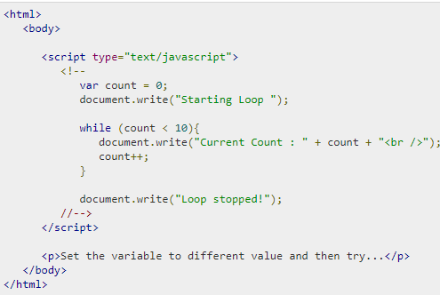
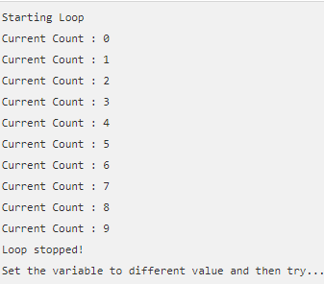
JavaScript
JavaScript The while Loop
The purpose of a while loop is to execute a statement or code block repeatedly as long as an expression is true. Once the expression becomes false, the loop terminates.

Slide 17
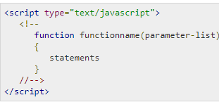
JavaScript
JavaScript – Functions
Like any other advanced programming language, JavaScript also supports all the features necessary to write modular code using functions.
Syntax
The basic syntax is shown here

Slide 18
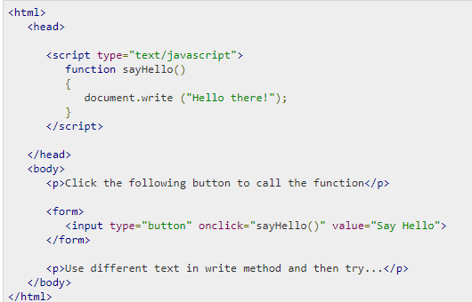
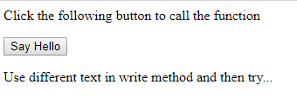
JavaScript
JavaScript – Functions

Slide 19
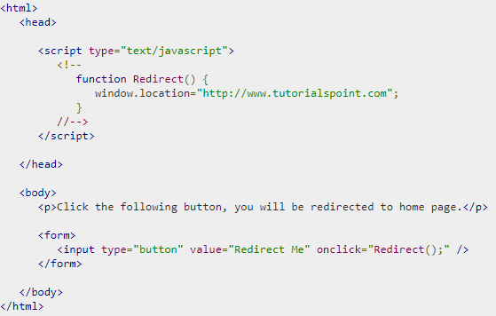
JavaScript
JavaScript - Page Redirection
It is quite simple to do a page redirect using JavaScript at client side. To redirect your site visitors to a new page, you just need to add a line in your head section as follows.

Slide 20
JavaScript
JavaScript - Dialog Boxes
An alert dialog box is mostly used to give a warning message to the users. For example, if one input field requires to enter some text but the user does not provide any input, then as a part of validation, you can use an alert box to give a warning message
Nonetheless, an alert box can still be used for friendlier messages. Alert box gives only one button "OK" to select and proceed

Slide 21
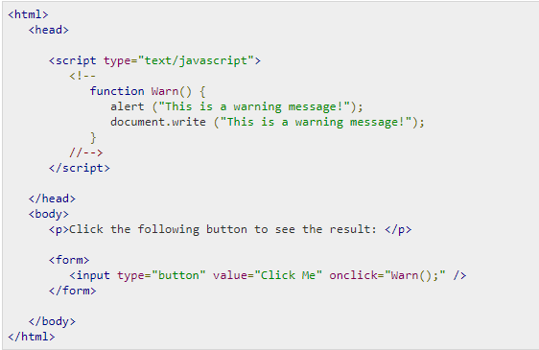
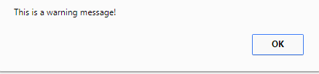
JavaScript
JavaScript - Dialog Boxes

Slide 22
JavaScript
JavaScript - Dialog Boxes
Confirmation Dialog Box:
A confirmation dialog box is mostly used to take user's consent on any option. It displays a dialog box with two buttons: OK and Cancel.
If the user clicks on the OK button, the window method confirm() will return true. If the user clicks on the Cancel button, then confirm() returns false. You can use a confirmation dialog box as follows.

Slide 23
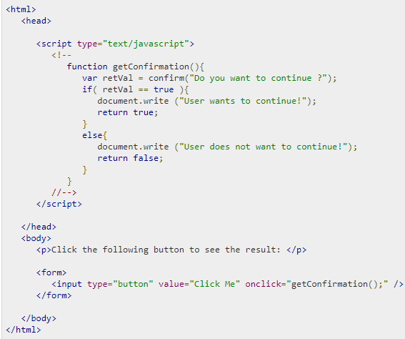
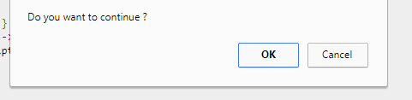
JavaScript
JavaScript - Dialog Boxes

Slide 24
JavaScript
JavaScript - Dialog Boxes
Prompt Dialog Box:
The prompt dialog box is very useful when you want to pop-up a text box to get user input
Thus, it enables you to interact with the user. The user needs to fill in the field and then click OK
This dialog box has two buttons: OK and Cancel. If the user clicks the OK button, the window method prompt() will return the entered value from the text box
If the user clicks the Cancel button, the window method prompt()returns null.

Slide 25
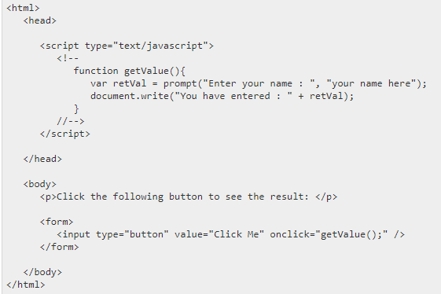
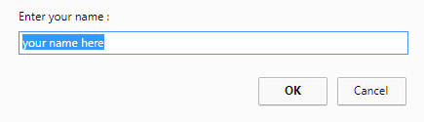
JavaScript
JavaScript - Dialog Boxes
Prompt Dialog Box:

Slide 26
Summary
JavaScript is a lightweight, interpreted programming language

